Slide 1
Teamwork
A poem
By
Jan nigro

Slide 2





Slide 3





Slide 4

Teamwork,teamwork,
Together we can make our dream work,
Then we will share
the joy of what
we've done,
Teamwork,teamwork.

Slide 5


It's fun to shoot the
basketball through
the hoop,
But if nobody passes then
nobody shoots.
And the really race just can't go on,
If nobody wants
to pass the baton.

Slide 6

We are the parts that make up the whole,
And we've got our eyes on a common goal.
Sometimes it can be a big plus,
When a you or a me becomes an us!

Slide 7

New Words
Teamwork--combined efforts of a group.
Hoop--wooden or iron ring.
Passes--move onward.
Relay race--race betwwen teams
of whicheach person
does part of the
distance.

Slide 8

Baton---short tube or stick carried in relay race.

Slide 9


Slide 10

To play cricket
we need bowler
batsman,coach.

Slide 11
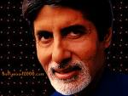

To make film
we need ----
-----
------

Slide 12

To run a school
we need ----
-----
-----

Slide 13
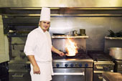

To run a resturant
we need ---- ------
------

Slide 14


For want of
a nail the
shoe was lost.

Slide 15

For want of
a shoe the
horse was
lost.

Slide 16

For want of
a horse the
rider was
lost.

Slide 17

For want a rider
the battle was
lost.

Slide 18


For want a
battle the kingdom
was lost.

Slide 19
And all for the
want of a
horse shoe nail.

Slide 20

Q--?
A.The shoe was
lost because
of the nail.

Slide 21

Q--?
The battle wa
lost because
of there was
no rider.

Slide 22

Q--?
A.The kingdom was
lost because the
battle could be
fought.

Slide 23
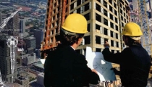

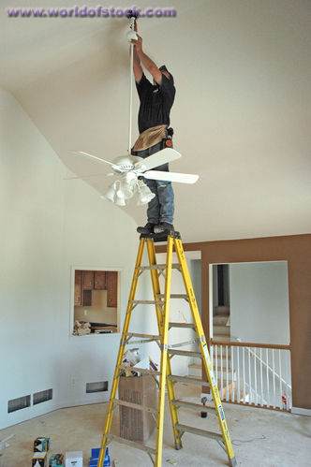




Slide 24
who is painting the walls?

Slide 25

Who is making the door?

Slide 26
Who is the man on the ladder?

Slide 27
Who is holding a ladder?

Slide 28


Slide 29


Slide 30

TEAM WORK

Slide 31


Slide 32
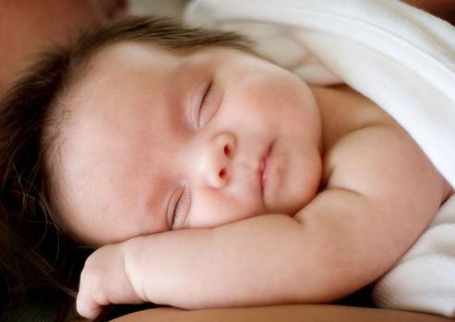
Teamwork ,teamwork,
Together we can make
Our dream work

Slide 33

THEN WE’LL SHARE THE JOY OF WHAT WE’VE DONE

Slide 34
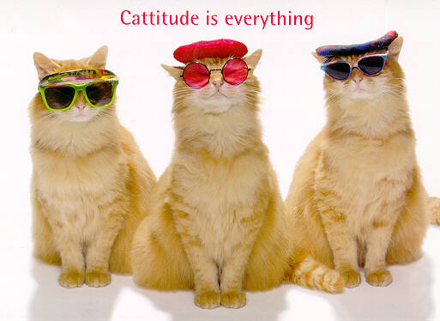
TEAMWORK EVERYONE

Slide 35
IT’S FUN TO SHOOT THE BASKETBALL
THROUGH THE HOOP BUT IF NOBODY PASSES
THEN
NOBODY SHOOTS

Slide 37


AND THE RELAY RACE JUST CAN’T GO ON,IF NOBODY WANTS TO
PASS THE BATON

Slide 38
WE ARE THE PARTS THAT MAKE UP THE WHOLE AND WE’VE GOT OUR EYES ON A COMMON GOAL SOME TIME IT CAN BE A BIG PLUS
WHEN A YOU OR A ME BECOMES AN US

Slide 39
NEW WORDS
TEAMWORK
GOMBINED EFFORT OF A GROUP

Slide 40
HOOP
WOODEN OR IRON RING TRUNDLED ALONG BYCHILD

Slide 41
PASSES
MOVE ONWARD

Slide 42
RELAY RACE
RACE BETWEEN TEAMS OF WHICH EACH PERSON DOES PART
OF THE DISTANCE

Slide 43
BATON
SHORT TUBE OR STICK
CARRIED IN RELAY RACE

Slide 44
RHYMING WORDS
PLUS | US
DONE | ONE
GOAL | WHOLE
TEAM | BEAM

Slide 45
SHORTEN FORM
WE WILL | WE’LL
YOU HAVE | YOU’VE
WE ARE | WE’RE
CANNOT | CAN’T
THERE IS | THERE’S
THEY ARE | THEY’RE
WE HAVE | WE’VE
WHAT HAVE | WHAT’VE

Slide 46
SOME GROUP ACTIVITY

Slide 47

GROUP ACTIVITY

Slide 48
GROUP ACTIVITY

Slide 49
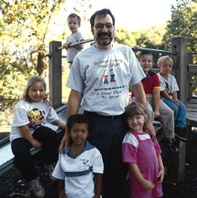
GROUP ACTIVITY

Slide 50
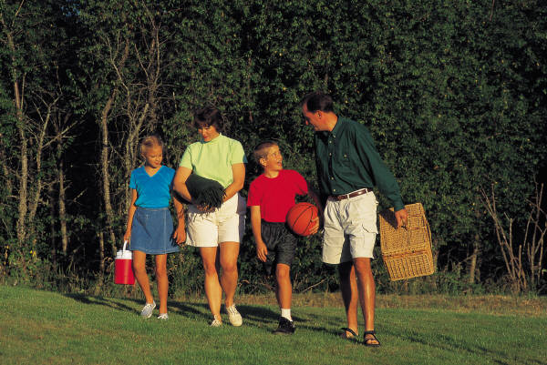
GROUP ACTIVITY

Slide 51
Good old lessons in teamwork
from an age-old fable
The Tortoise
And
The Hare

Slide 52
Once upon a time a tortoise and a hare had an argument about who was faster.
That’s not true.
The fastest runner is
me!
I’m the fastest
runner.

Slide 53
They decided to settle the argument with a race. They agreed on a route and started off the race.
Fine!
Ok, let’s have
a race.

Slide 54
The hare shot ahead and ran briskly for some time. Then seeing that he was far ahead of the tortoise, he thought he'd sit under a tree for some time and relax before continuing the race.
Poor guy! Even if I take a nap, he could not catch up with me.

Slide 55
He sat under the tree and soon fell asleep.

Slide 56
The tortoise plodding on overtook him and soon finished the race, emerging as the undisputed champ.

Slide 57
The hare woke up and realized that he'd lost the race.

Slide 58
The moral of the story is that slow and steady wins the race.
This is the version of the story that we've all grown up with.

Slide 59
The story continues …

Slide 60
The hare was disappointed at losing the race and he did some soul-searching. He realized that he'd lost the race only because he had been overconfident, careless and lax. If he had not taken things for granted, there's no way the tortoise could have beaten him.
Why did I lose the race?

Slide 61
So he challenged the tortoise to another race. The tortoise agreed.
Ok.
Can we have
another race?

Slide 62
This time, the hare went all out and ran without stopping from start to finish. He won by several miles.

Slide 63
The moral of the story?
Fast and consistent will always beat the slow and steady. If you have two people in your organization, one slow, methodical and reliable, and the other fast and still reliable at what he does, the fast and reliable chap will consistently climb the organizational ladder faster than the slow, methodical chap.
It's good to be slow and steady; but it's better to be fast and reliable.

Slide 64
But the story doesn't end here …

Slide 65
The tortoise did some thinking this time, and realized that there's no way he can beat the hare in a race the way it was currently formatted.
How can I can win the hare?

Slide 66
He thought for a while, and then challenged the hare to another race, but on a slightly different route.
The hare agreed.
Can we have another race? This time we’ll go through a different route.
Sure!

Slide 67
They started off. In keeping with his self-made commitment to be consistently fast, the hare took off and ran at top speed until he came to a broad river. The finishing line was a couple of kilometers on the other side of the river.
Goal

Slide 68
The hare sat there wondering what to do. In the meantime the tortoise trundled along, got into the river, swam to the opposite bank, continued walking and finished the race.
What should I do?

Slide 69
The moral of the story?
First identify your core competency and then change the playing field to suit your core competency.
In an organization, if you are a good speaker, make sure you create opportunities to give presentations that enable the senior management to notice you.
If your strength is analysis, make sure you do some sort of research, make a report and send it upstairs.
Working to your strengths will not only get you noticed, but will also create opportunities for growth and advancement.

Slide 70
The story still hasn't ended …

Slide 71
The hare and the tortoise, by this time, had become pretty good friends and they did some thinking together. Both realized that the last race could have been run much better.

Slide 72
So they decided to do the last race again, but to run as a team this time.
Great! I think we could do it much better, if we two help each other.
Hi, buddy. How
about doing our last
race again?
Hi, buddy. How
about doing our last
race again?

Slide 73
They started off, and this time the hare carried the tortoise till the riverbank.

Slide 74
There, the tortoise took over and swam across with the hare on his back.

Slide 75
On the opposite bank, the hare again carried the tortoise and they reached the finishing line together. They both felt a greater sense of satisfaction than they'd felt earlier.

Slide 76
The moral of the story?
It's good to be individually brilliant and to have strong core competencies; but unless you're able to work in a team and harness each other's core competencies, you'll always perform below par because there will always be situations at which you'll do poorly and someone else does well.
Teamwork is mainly about situational leadership, letting the person with the relevant core competency for a situation take leadership.

Slide 77
There are more lessons to be learnt from this story.
Note that neither the hare nor the tortoise gave up after failures. The hare decided to work harder and put in more effort after his failure. The tortoise changed his strategy because he was already working as hard as he could.
In life, when faced with failure, sometimes it is appropriate to work harder and put in more effort. Sometimes it is appropriate to change strategy and try something different. And sometimes it is appropriate to do both.
The hare and the tortoise also learnt another vital lesson. When we stop competing against a rival and instead start competing against the situation, we perform far better.

Slide 78
THANK YOU

