Slide 1
Sharing our feelings lesson 13

Slide 2
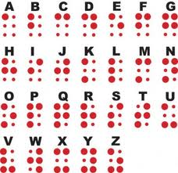
BRAILLE SCRIPT

Slide 3
Louis Braille

Slide 4
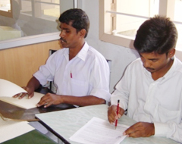
Differenciate these two men in the picture

Slide 5
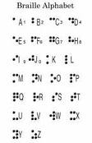
Braille alphabet

Slide 6
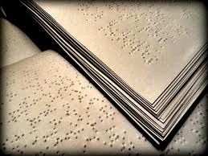
These books are thick and have rows on raised dots

Slide 7
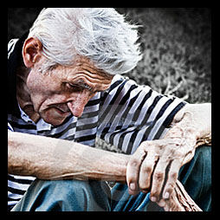
Kind of problems people have in the old age
Loss of self control

Slide 8
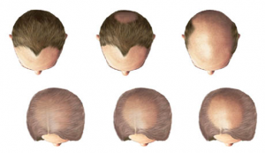
Common hair loss

Slide 9
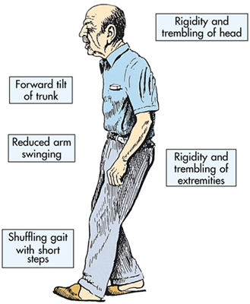

Slide 10
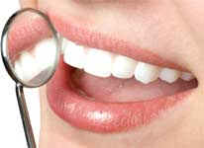
Loss of teeth

Slide 11
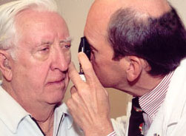
Loss of sight

Slide 12
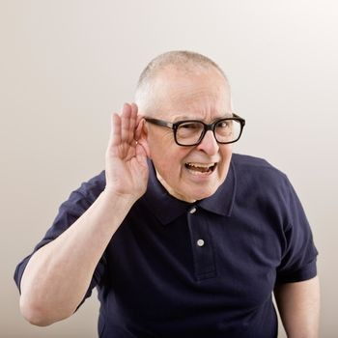
Hearing loss

Slide 13
Things used by a blind person

Slide 14
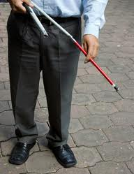
Red cane stick

Slide 15
glasses

Slide 16
Evaluation
How do you help your grandparents ?
discuss

Slide 17
Who has founded Braille script

