Slide 1
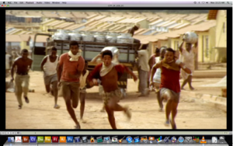
RUN AWAY FROM CITY

Slide 2
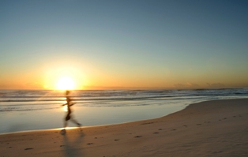
RUN INTO THE SUN

Slide 3
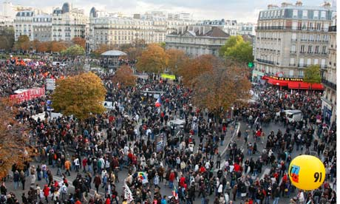
RUN OUT TO THE COUNTRY

Slide 4
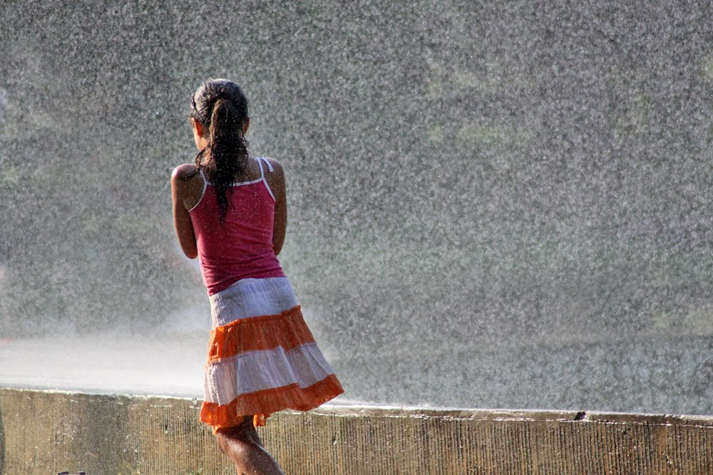
RUN IN THE RAIN DROP

Slide 5
RUN NEATH THE TREES

Slide 6
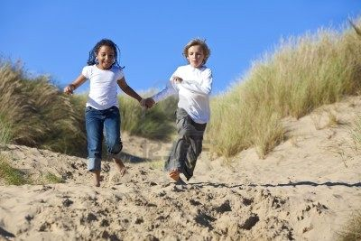
RUN LITTLE RACES

Slide 7
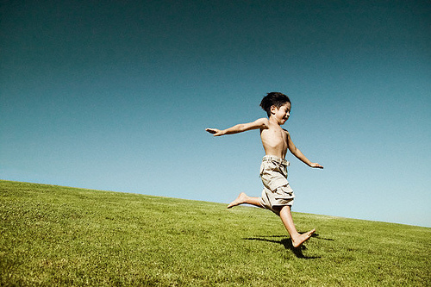
RUN DOWN HILLSIDE

Slide 8
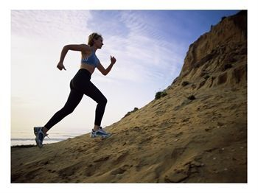
RUN UP THE hills

Slide 9
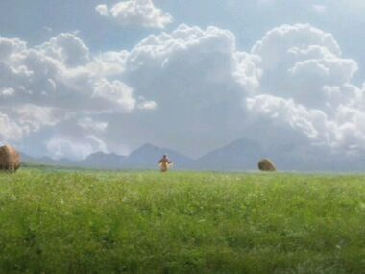
RUN THROUGH THE MEADOW

Slide 10
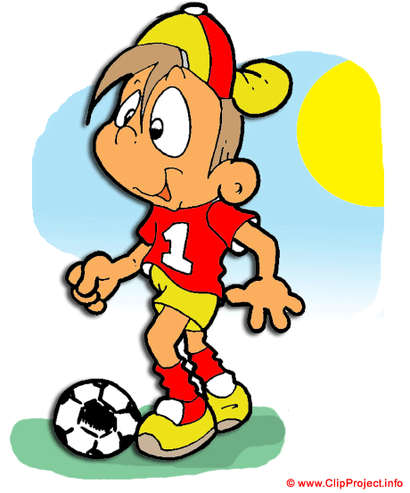
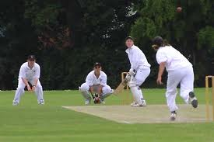
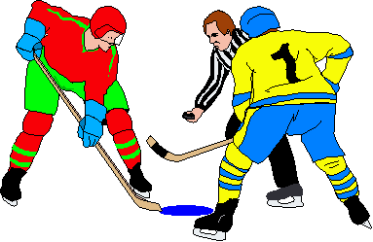
GAMES NEED RUNNING

