Slide 1
Little tiger, big tiger class III

Slide 2
Little tiger, big tiger

Slide 3
There was a mother tiger and her small tiger cub. When the sky was dark, the mother tiger
hunted for deer and pig. The
tiger cub stayed close by his
mother's side.

Slide 4
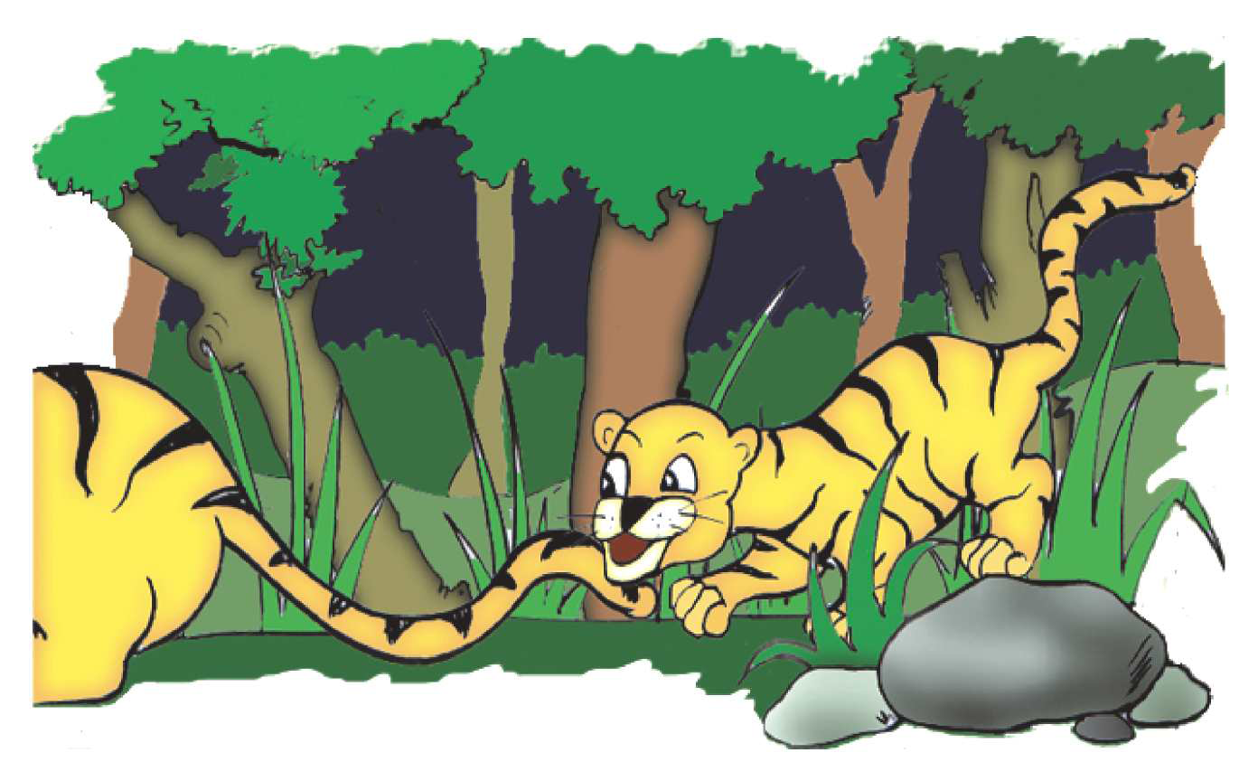
If the moon was bright, the mother tiger lay down and waited for the dawn. She twitched the tip of her tail, and the tiger cub pounced on her tail again and again. 69

Slide 5
One night the mother tiger was tired and closed her eyes. The tiger cub saw a tiny frog, hopping along the ground. The tiger cub pounced, but the frog hopped away. He chased the fro

Slide 6
The tiger cub was frightened when he saw a tiger

Slide 7
But, there came a year when the small tiger cub was a fullgrown tiger.

Slide 8
But a roar f i l l e d t h e jungle, the roar of the mother tiger! She faced the other tiger and he went away.

Slide 9
Word Game: Can you place these letters in their right
?
s e m o u ______________________________
r e s o h ________________________________
o i n l ________________________________
p e s h e ________________________________
r e d e ________________________________
l u b l ________________________________
g i t e r ________________________________
f o l w ________________________________

Slide 10
iii. The animals/birds in column A have to reach their
homes in column B. Find out where they live.
A B
A bee burrow
An ant web
A duck nest
A tiger lives in a Den
A rabbit hive
A spider pond
A sparrow ant hill

Slide 11
Where did the mother tiger and her small tiger cub live?
a. near a river
b. near a forest c . near a mountain
d. near a sea

Slide 12
What did the mother tiger hunt when the sky was dark?
a. sheep and goats
b. deer and pigs
c. fish and frogs
d. donkeys and horses

Slide 13
List these animals under domestic and wild animals jackal,fox,tiger,dog,cow,elephant,bear,sheep,goat,buffalo
Domesticanimal wild animal

Slide 14
Do you have any pet ? Draw your pet animal and give it a pet name too

