Slide 1
Sing and enjoy this poem

Slide 2
Once I Saw a Little Bird
Come hop , hop, hop.

Slide 3
I cried, “Little bird,
Will you stop ,stop, stop ?.”

Slide 4
I Was going to the window
To say, "How do you do?”

Slide 5
But he Shook His Little Tail
And away he flew.

Slide 6
Match the Rhyming words.
DO ____ Mail
Hop STOP ____
Tail ____ Flew

Slide 7
Evaluation

Slide 8
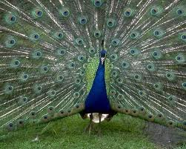
Can you name this animal this Bird

Slide 9
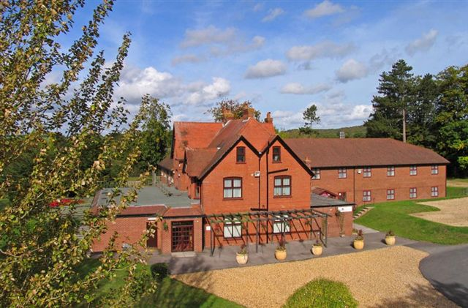
CAN YOU FILL COLOURS
THE ROOF IS _____________
THE FLOOR IS _________
THE WALLS ARE ______________
THE PLANTS ARE _______________
THE DOORS AREB _____________
THE WINDOWS ARE _______________
Notes:
The roof is ______________
The walls are ________________
The windows are _______________________
The door is ____________________________
The plants are ____________________________
The floor is ______________________________

Slide 10
NAME THESE COLOURS.

Slide 11
FIND DOUBLE
LETTER WORDS
SAW
LITTLE
STOP
SHOOK
TALL
ONCE

Slide 12
FIND OUT HIDDEN WORDS
WINDOW____________
TALL ______________
SHOOK ______________
STOP ___________________
AWAY _____________________

Slide 13
GIVE ONE WORD ANSWER
YOU OPEN IT AND GET FRESH AIR _____________________
VERY SMALL __________________
YOU CANNOT, ONLY BIRDS CAN _________________

Slide 14
WORD GRID ---
FIND OUT WORDS FROM THE GRID
L | I | T | T | L | E | S | R
B | A`` | A | A | T | D | H | F
I | T | L | I | S | T | O | P
R | K | L | L | T | D | O | R
D | F | F | R | H | D | K | W
A | W | A | Y | I | Y | D | F
R | Y | R | C | C | O | M | E

Slide 15
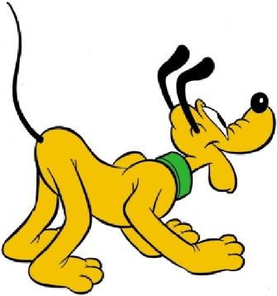
IDENTIFY THESE PICTURES

