Slide 1
LEFT RIGHT LESSON 22

Slide 2
LEFT HAND

Slide 3
Right hand

Slide 4
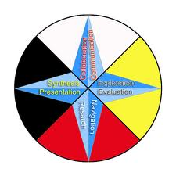
DIRECTIONS

Slide 5
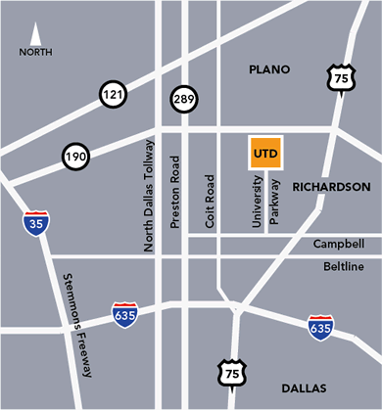

Slide 6
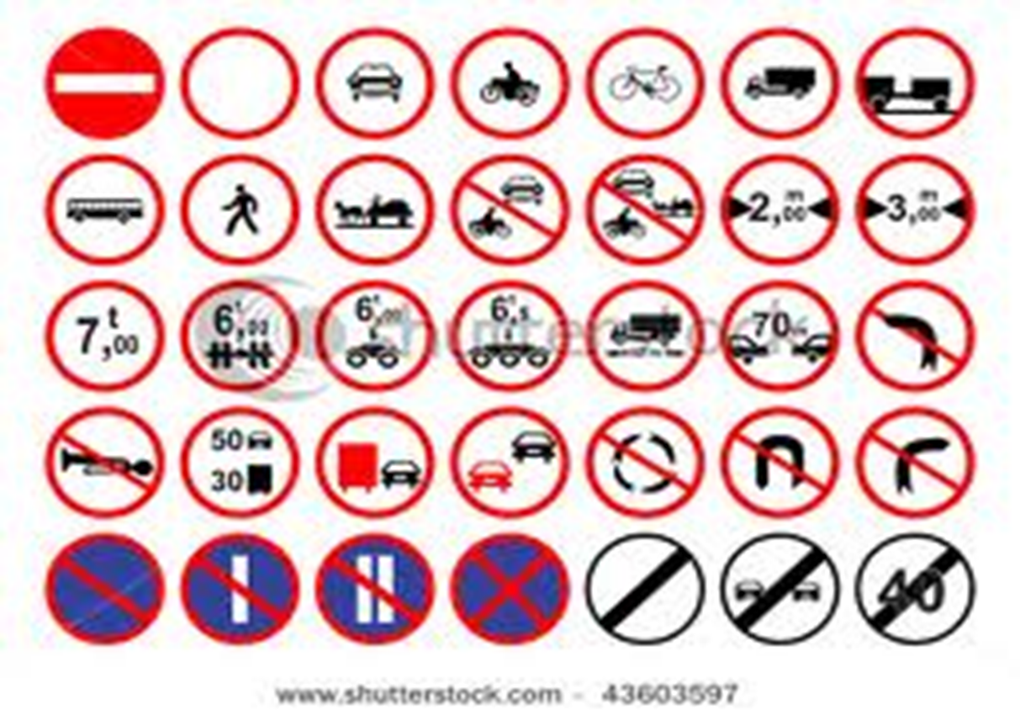
ROAD SIGN

Slide 10
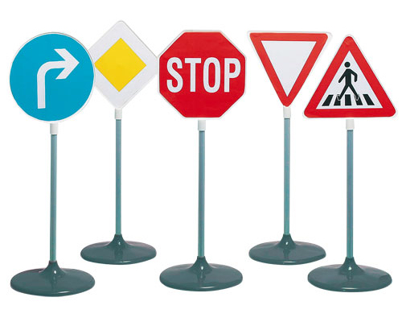
Road signs

Slide 11
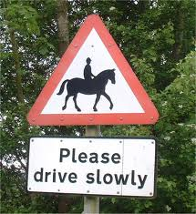

Slide 14
Evaluation
Where does the sun rise /
How can you find out the east direction ?

Slide 15
Can you tell who is sitting to your right ? What is in front of you ?

