Slide 1
Granny Granny Please Comb My Hair

Slide 2
Granny Granny please comb my hair you always take your time you always take such care

Slide 3
You put me to sit on a cushion
between your knees
you rub a little coconut oil
parting gentle as a breeze

Slide 4
Mummy Mummy she's always ina hurry-hurry rush she pulls my hair sometimes she tugs

Slide 5
But Granny
you have all the time in the world
and when you're finished
you always turn my head and say
'Now who's a nice girl'

Slide 6
GIVE ONE RHYMING WORDS
HERE .................................
KNEES …………………….
SAY ……………………
OIL …………………….

Slide 7
MAKE TINY WORDS – GRAND PARENTS

Slide 9
vowels
nim

Slide 10
a e i o u
a e i o u
a e i o u
a e i o u
a e i o u
a e i o u
a e i o u

Slide 11
1 2 3 4 5
a e i o u
a e i o u
1 2 3 4 5

Slide 12
a e i o u
a e i o u
a e i o u
a e i o u

Slide 13
an
a e i o u

Slide 14
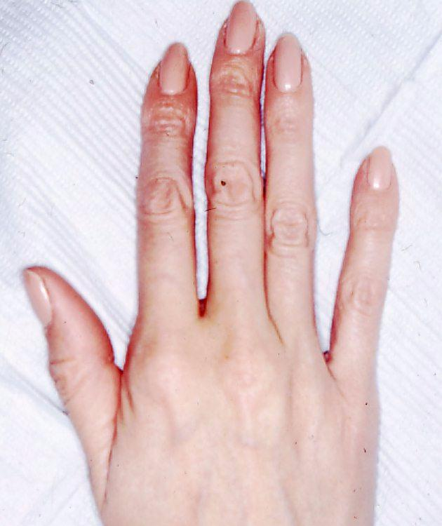
i
o
e
u
a
a e I o u

Slide 15
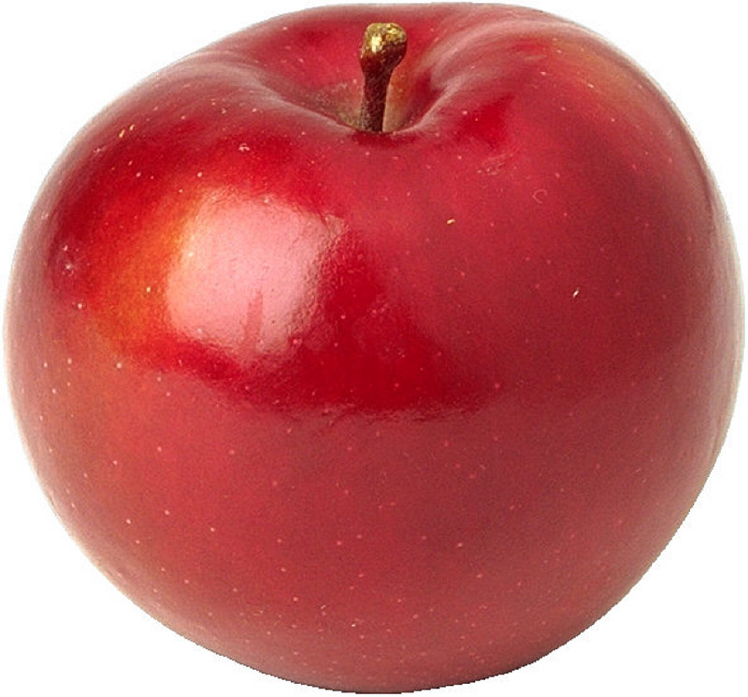
An apple

Slide 16
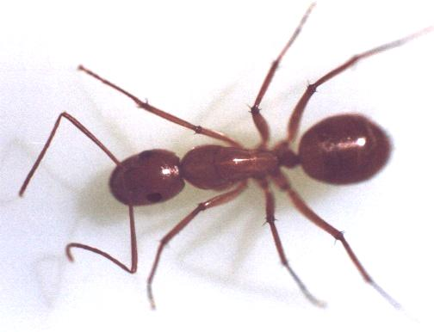
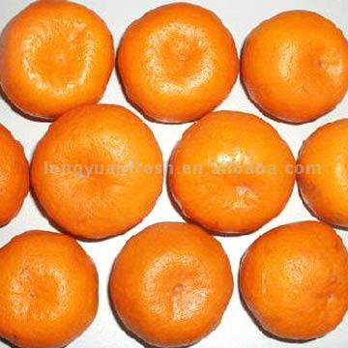
An ant

Slide 17
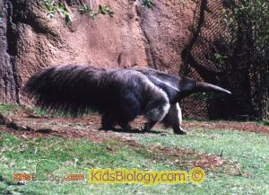
An anteater

Slide 18
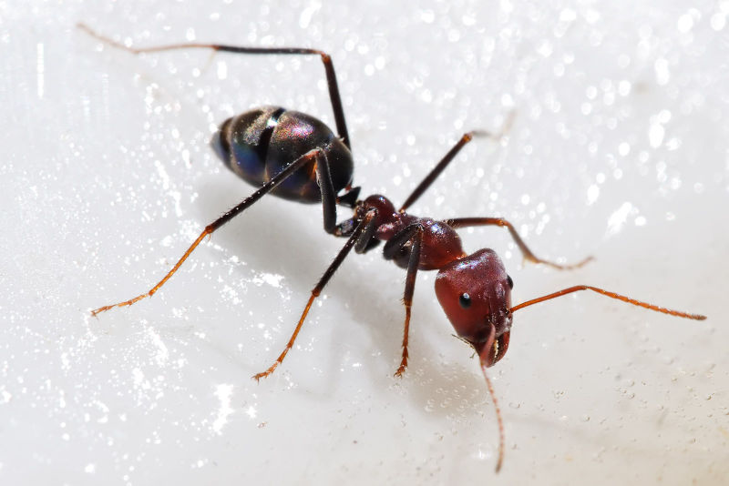
An ant

Slide 19
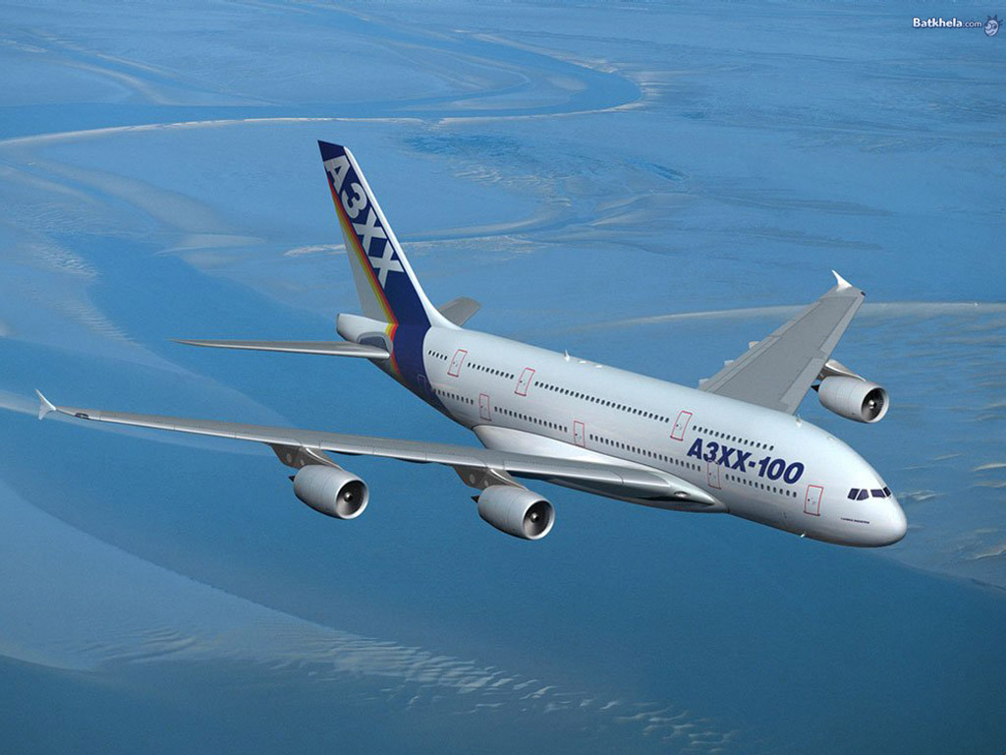
An aeroplane

Slide 20
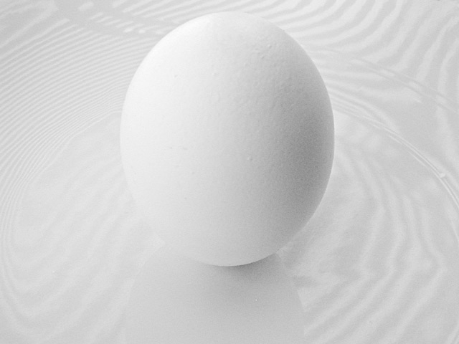
An egg

Slide 21
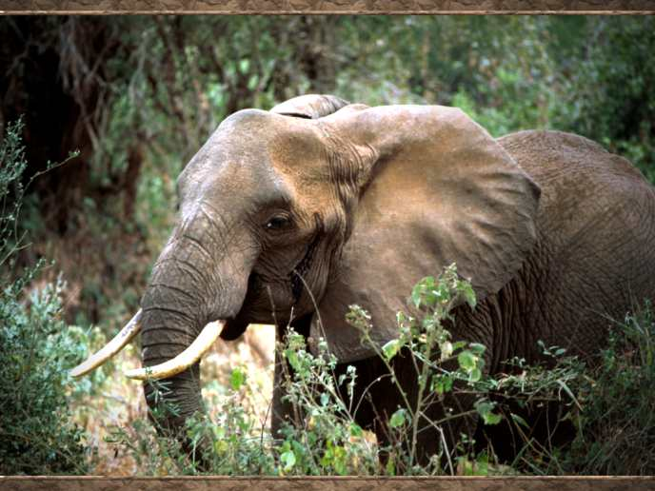
An elephant

Slide 22
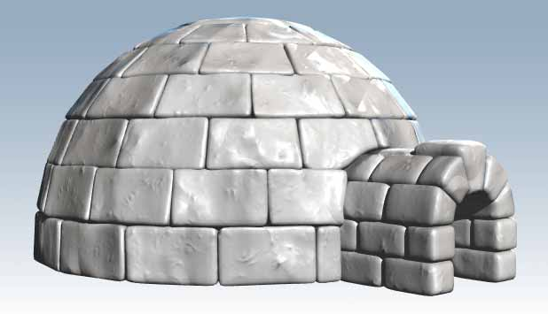
An igloo

Slide 23
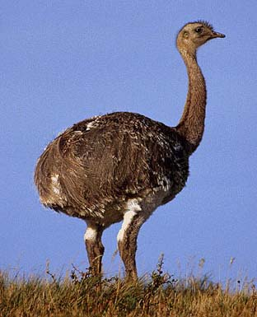
An ostrich

Slide 24
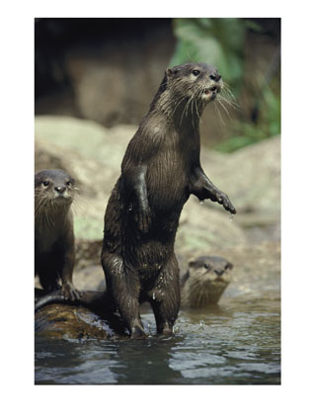
An otter

Slide 25
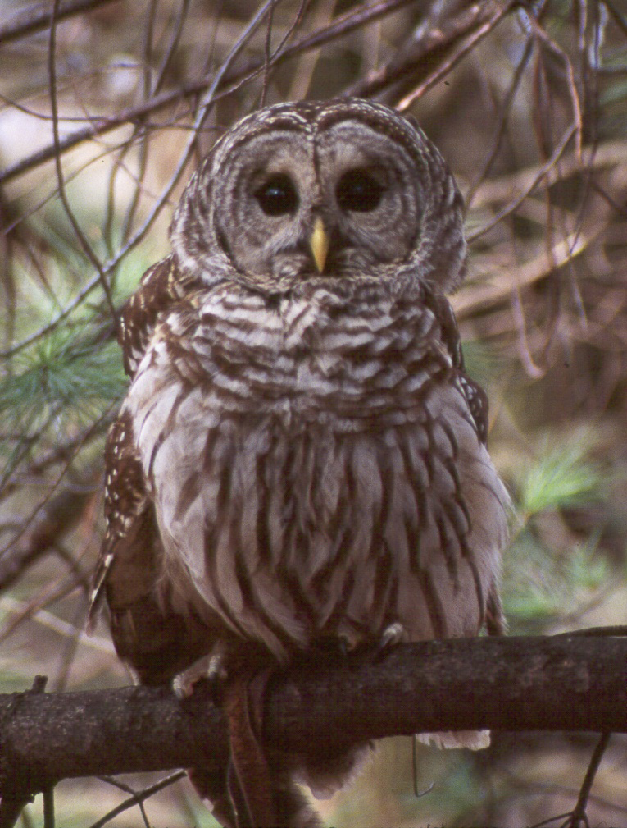
An owl

Slide 26
An umbrella

Slide 27
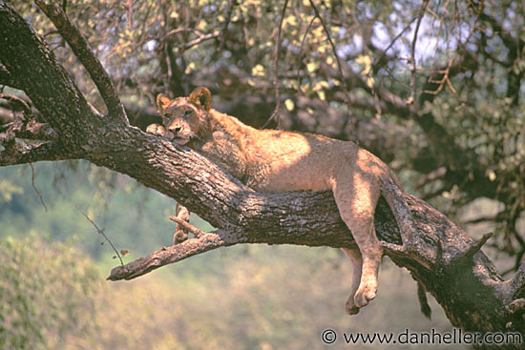
A lioness

Slide 28
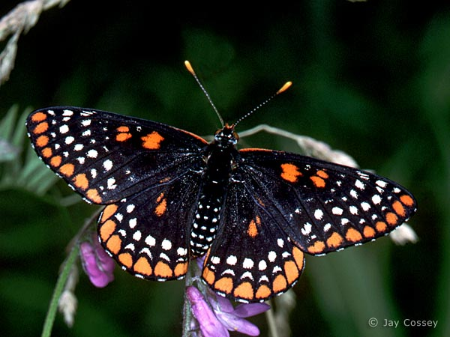
A butterfly

Slide 29
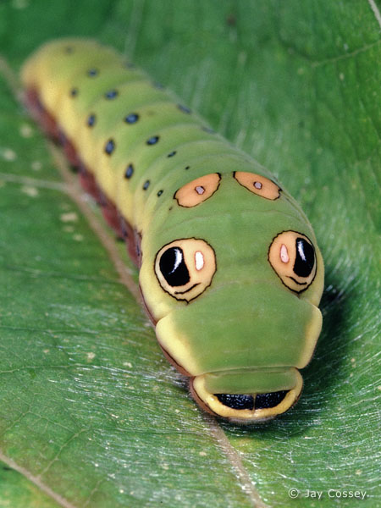
A caterpillar

Slide 30
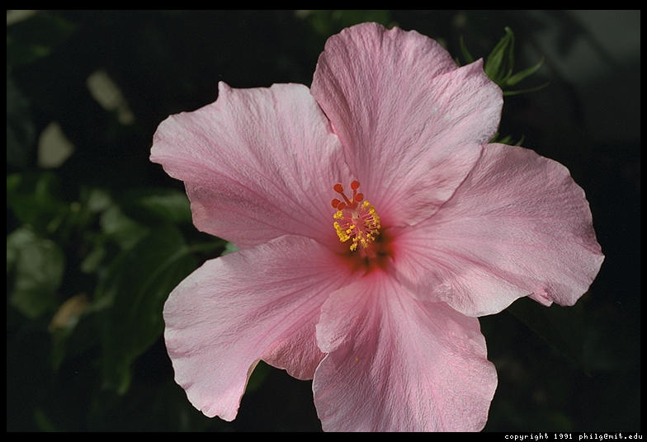
A flower

Slide 31
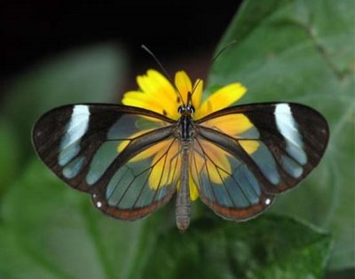
A butterfly

Slide 32
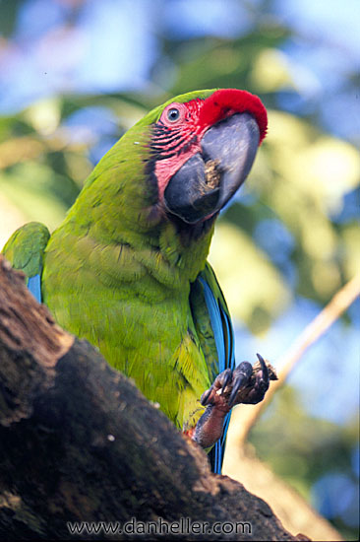
A parrot

Slide 33
LET’S SEE HOW MUCH WE HAVE LEARNT.

Slide 34
Fill in the blanks with a or an correctly.

Slide 35
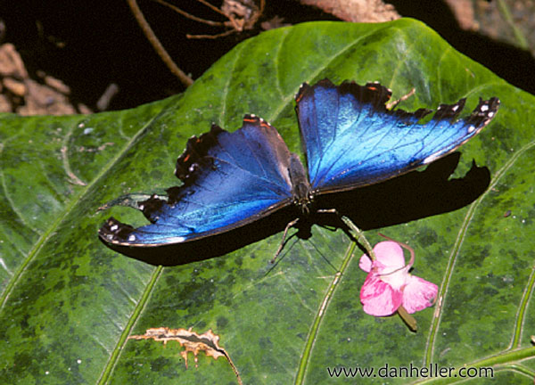
-- butterfly

Slide 36
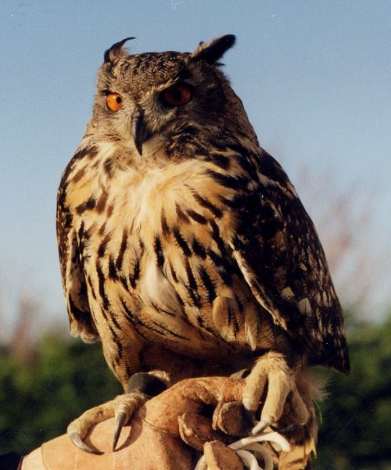
-- owl

Slide 37
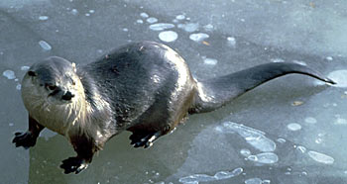
-- otter

Slide 38
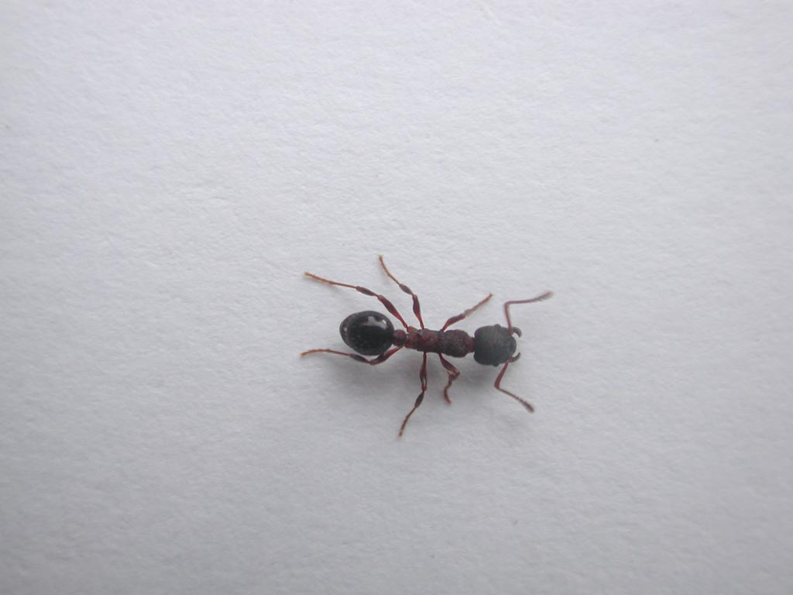
_ant

Slide 39
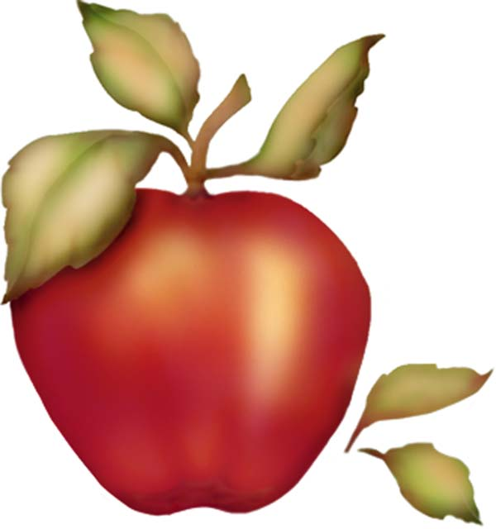
- apple

Slide 40
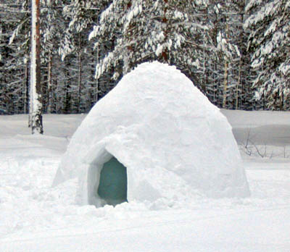
- igloo

Slide 41
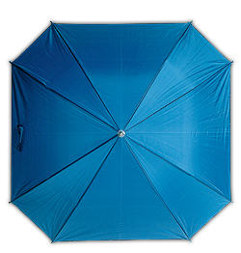
-- umbrella

Slide 42
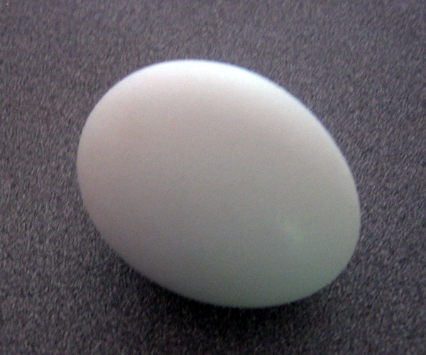
- egg

Slide 43
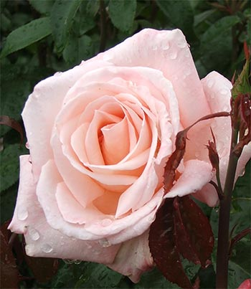
-- rose

Slide 44
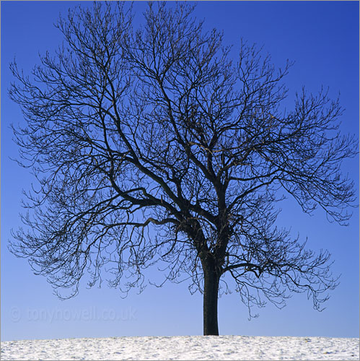
- tree

Slide 45
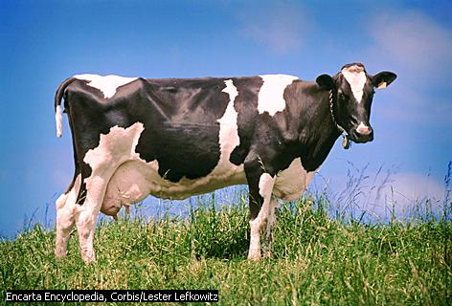
- cow

Slide 46
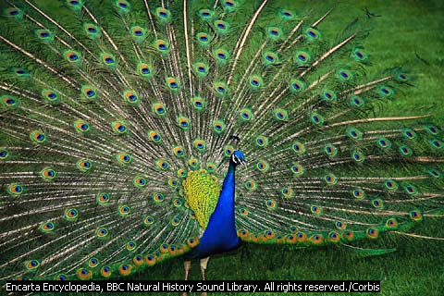
- peacock

Slide 47
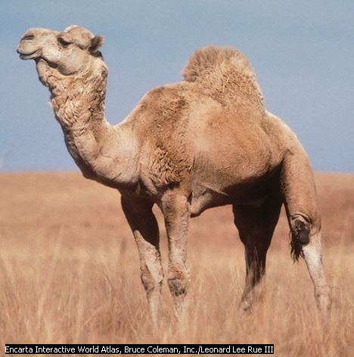
- camel

Slide 48
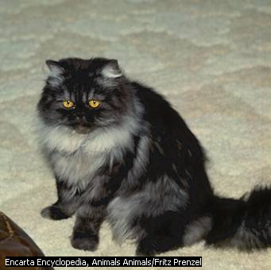
- kitten

Slide 49
Match the following
Pen
Book
Owl
Igloo
Kite
Nest
An
a

Slide 50
Match the following
Cat
Dog
Egg
Jug
Ostrich
Pen
Quill
orange
ant
An
a

