Slide 1
Robinson Crusoe
Discovers a Footprint

Slide 2
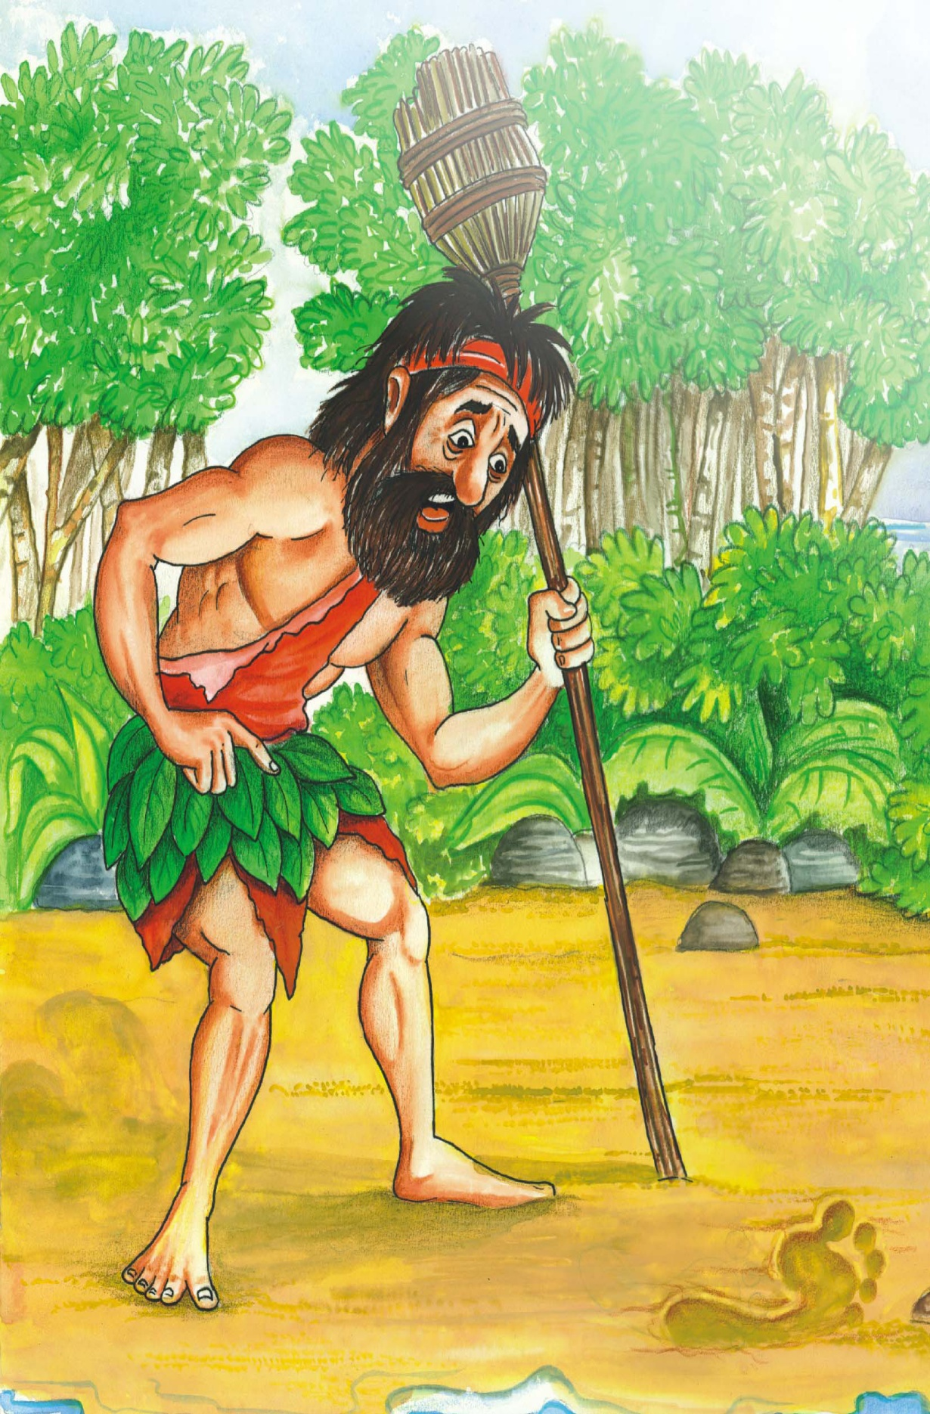
Robinson Crusoe’s ship had been destroyed by the sea. He had been alone for many years and longed for company. One day he discovers a footprint on the sand. Let’s find what he did then.

Slide 3
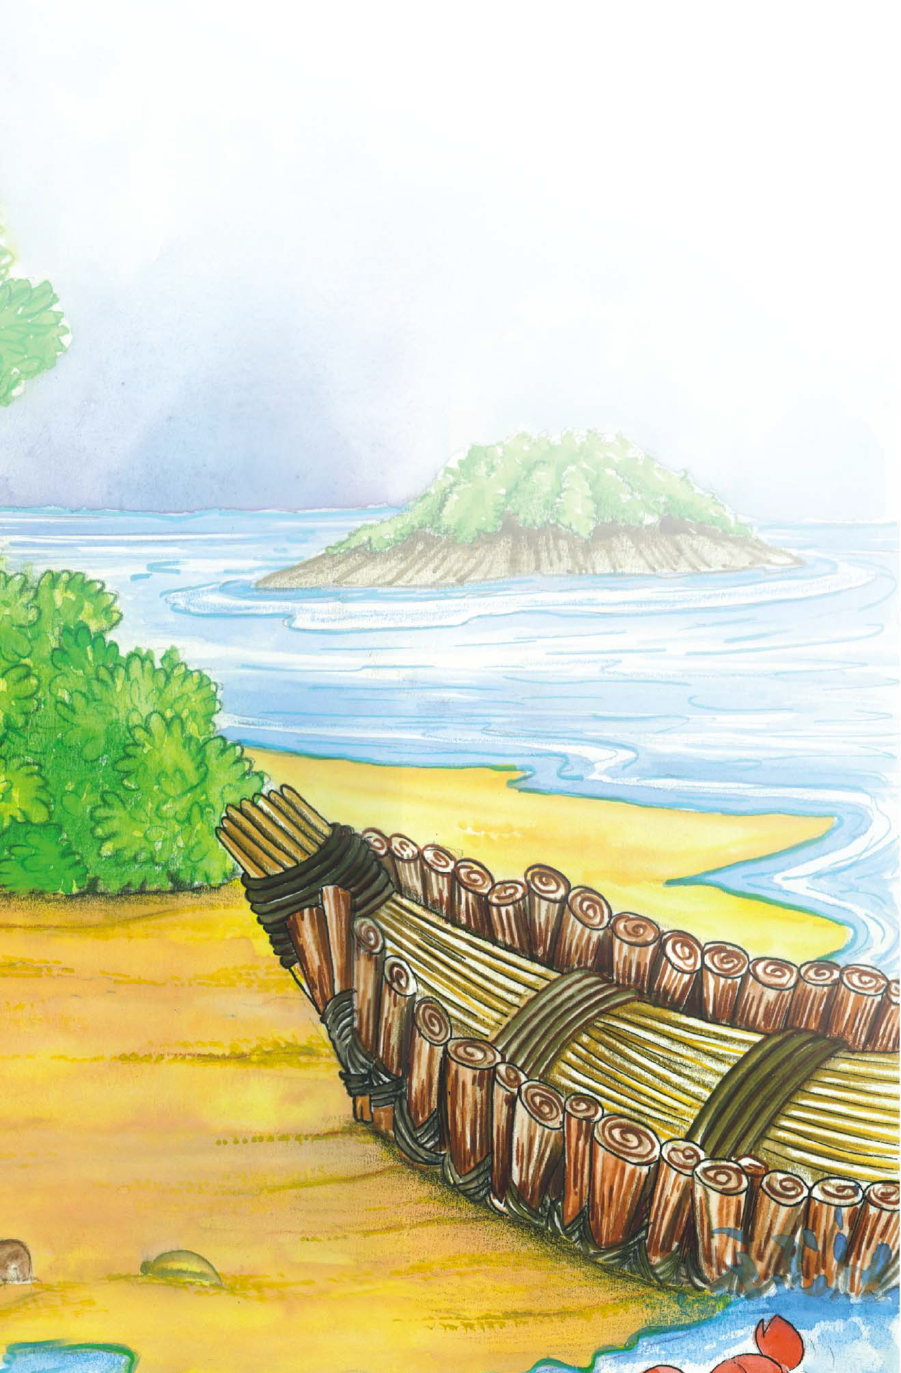
One day, when I was going towards my boat, I was surprised to see the footprint of A man on the sand.
I stood amazed! I listened; I looked around me;
I could neither hear nor see anything. I went up higher to look down; I went up the shore and down
the shore , but it was no good; I could find no other
footprint but that one. I went to it again to see if there were any more footprints and to tell if it had
been my imagination. But I was not mistaken for, there was exactly the print of a foot-toes,heel,every part of a
foot. I couldn’t imagine how it came there.

Slide 4
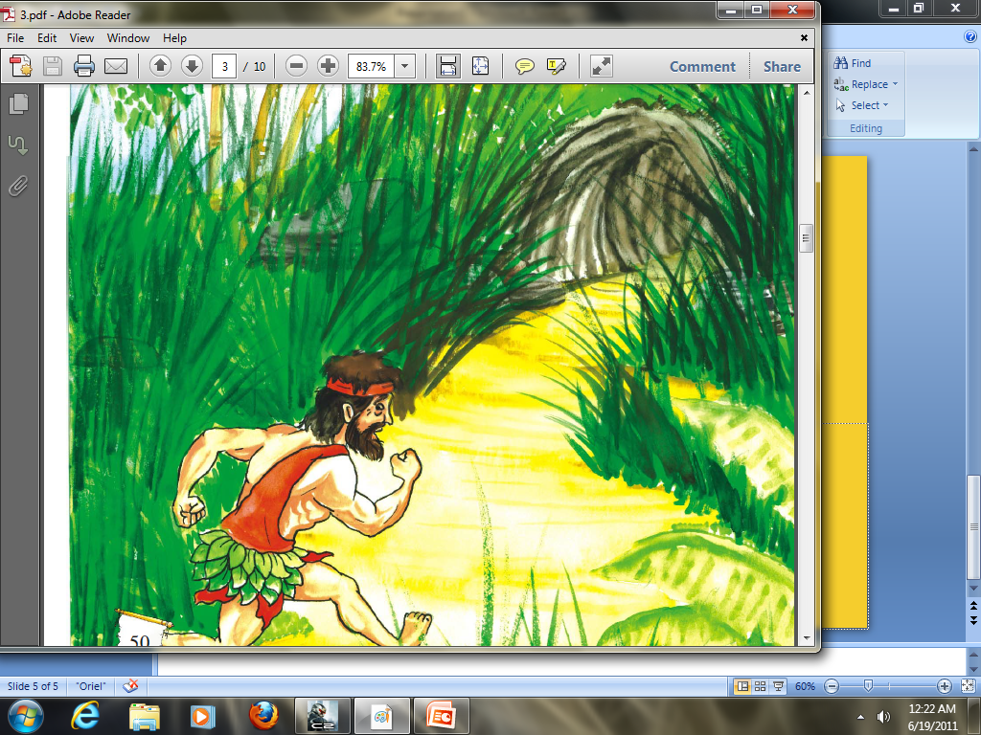
I stayed a long time thinking, but became more confused.
At last I returned home very frightened, looking behind me after every two or three steps, mistaking every bush and tree to be a man.
When I came to my cave, I ran inside it, as if was being chased, I don’t remember whether I used the ladder or went in by the hole in the rock, which I called the door. I ran for cover, faster than any animal could run.

Slide 5
I didn’t sleep that night. The more I thought about what I had seen, the more afraid I became. I thought it could one of the savages of mainland who had wandered out the sea, in a small boat.

Slide 6
Luckily I was not on the shore at that time, but what if he had seen my boat! If he had seen the boat he would have realised that someone lived in the island and would soon return with others to kill and eat me.

Slide 7
And so I lay fearful for many days and prayed for
protection . In doing so I was much comforted and began going out to investigate. But even now as I went forward, I looked behind me frequently. Because I was still very frightened .

Slide 8
However, as I went about for two or three days and saw nothing I became a little bolder. I decided to go down to shore again and examine the footprint once more. I decided to measure it with my own footmark.

Slide 9
As I came closer to the footprint, I realised that it could not be my footprint because I had not come to this part of the beach since a long time. Secondly, as I placed foot alongside that footprint, it seemed larger than my own.
My fear returned! I went home again, believing that there someone there.
The island was inhabited!

Slide 11
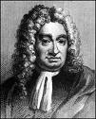
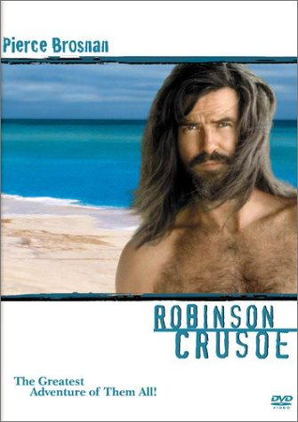
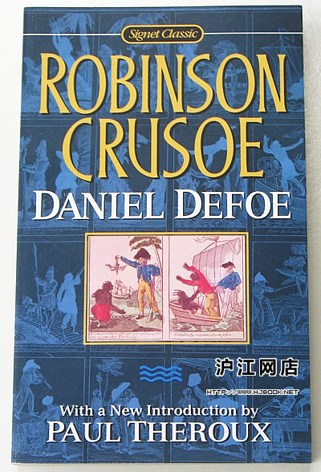
Daniel Defoe (1661-1731) Father of English Novel

Slide 12
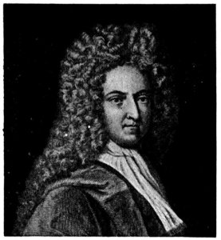
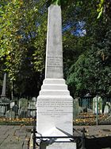
Memorial to "Daniel Defoe", Bunhill Fields, City Road, London.

Slide 13
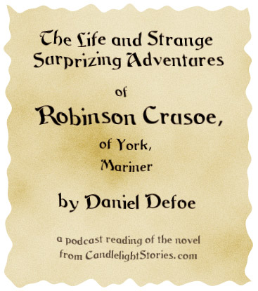
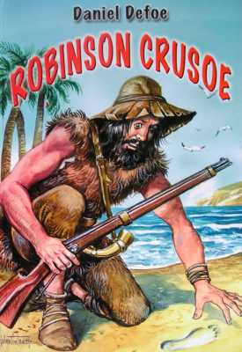

Slide 14
Robinson Crusoe on the Screen

Slide 15
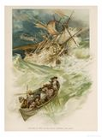
II Main plot of the novel
When does the story take place?
In the middle of the 17th century
Why does Crusoe leave England?
He dreams to be a sailor
When does Crusoe first settle?
in Brazil

Slide 16
CHANGE THE NOUN FORMS
IMAGINE -----------
CONFUSE -----------------
EXAMINE --------------------
PROTECT -----------------------
REALISE--------------------------

Slide 17
PAST TENSE
THINK ---------------
BECOME ----------------- SEE ---------------------------
GO ------------------------------
LISTEN -----------------
IMAGINE ----------------------
CHASE --------------------------
RETURN

Slide 18
OPPOSITE WORDS
SMALL -----------------
INSIDE ----------------------
HIGHER ---------------------
BEGIN -------------------------
LARGER -----------------------
LUCKILY--------------------

Slide 19
UNJUMBLE THE SENTENCES
Alone was not Robinson an island on
-----------------------------------------------------
Was island inhabited
------------------------------------------------------
Was I afraid I now
--------------------------------------------------------
I around looked me
---------------------------------------------------------

Slide 20
Try to make a story

Slide 21
Observe this picture carefully
Where did you see the footprints

Slide 22
This is the footprint of the first man on the moon . His name was----------------

Slide 23
First man on moon

Slide 24
How would you feel if you saw unknown foot print outside your frontdoor

Slide 25
If you are alone at home and suddenly someone knock at your door ,what would you do

