Slide 1
Clouds
Class- I
Sub-English

Slide 2
It is hot.
The sky is blue.

Slide 3
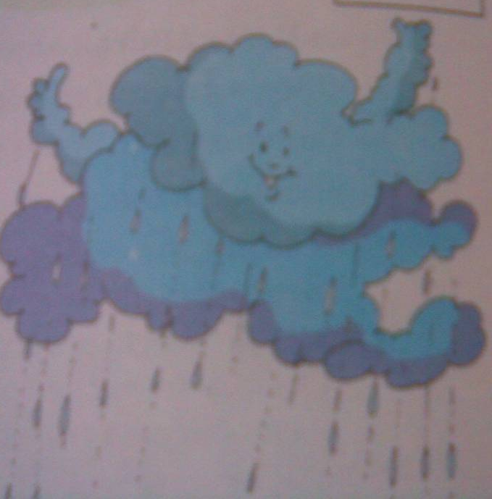
A little cloud comes
looking for you.

Slide 4
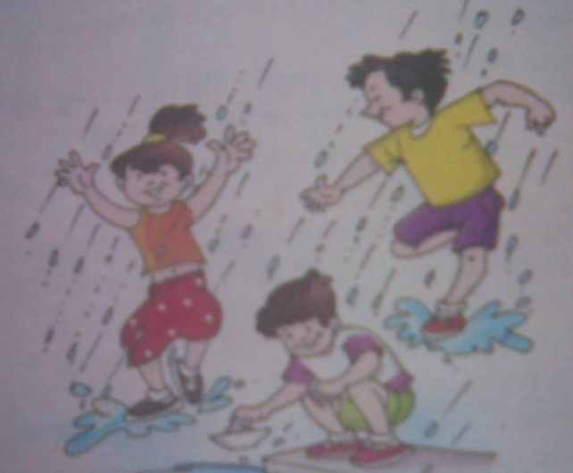
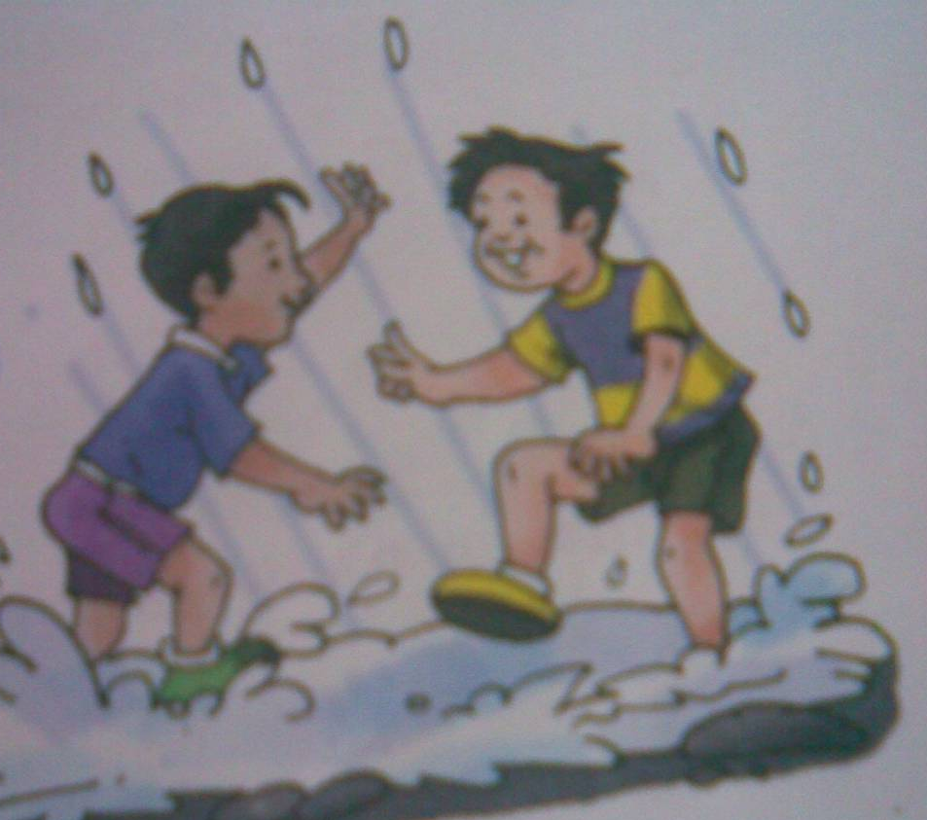
More clouds come.

Slide 5

They bring rain.
puddle

Slide 6
Sing and dance.
It’s cool again!

Slide 7
Rhyming words
cot
dot
hot
pot

Slide 8
cry
dry
fly
sky

Slide 9
drain
grain
pain
rain

Slide 10
bring
ring
sing
wing

Slide 11
Evaluation sheet
Find out from the poem opposite words
Warm _________
Big ____________
Go ____________
Big _____________

Slide 12
Answer the following questions
What is the colour of the sky ?
________________________
What is the title of the poem ?
________________________

