Slide 1
After bath

Slide 2


Slide 3
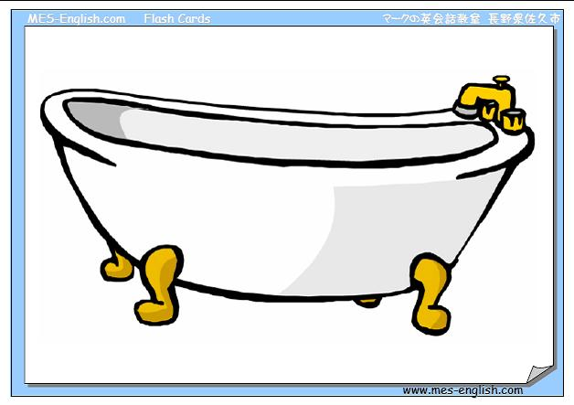
Bath

Slide 4
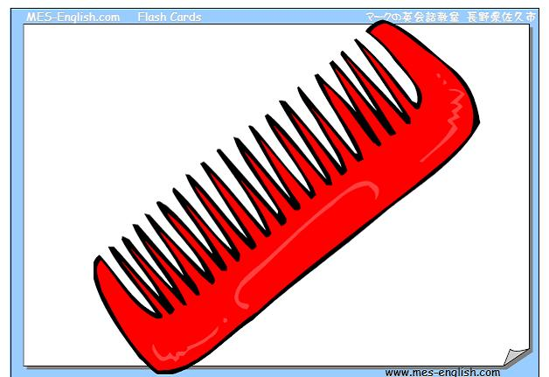
Comb

Slide 5
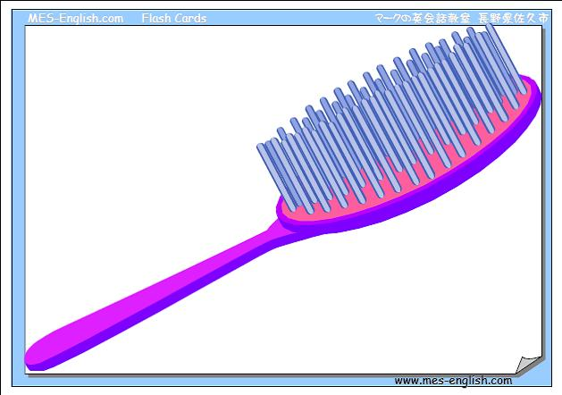
Brush

Slide 6
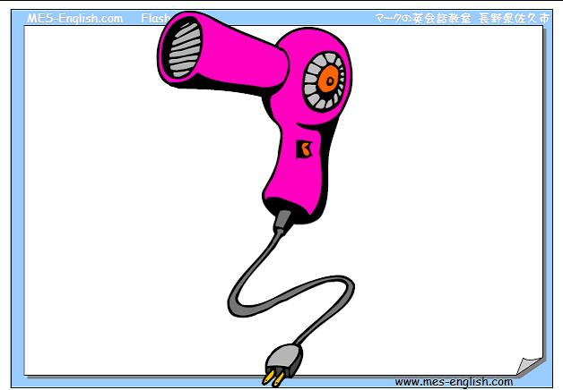
Hair dryer

Slide 7

Laundry basket

Slide 8
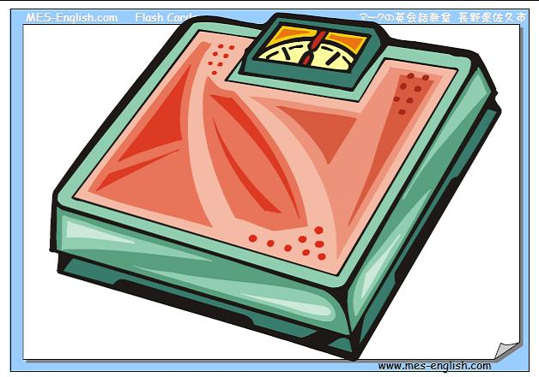
Scales

Slide 9

Razor

Slide 10
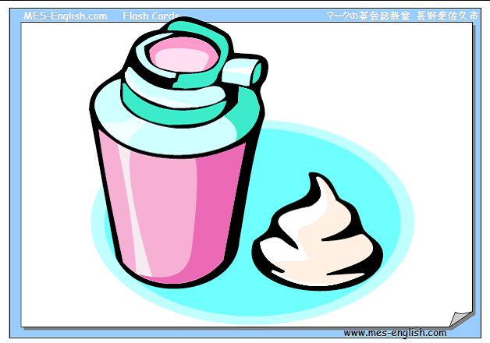
Shaving cream

Slide 11
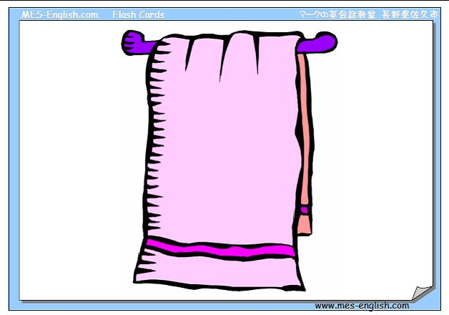
Towel

Slide 12
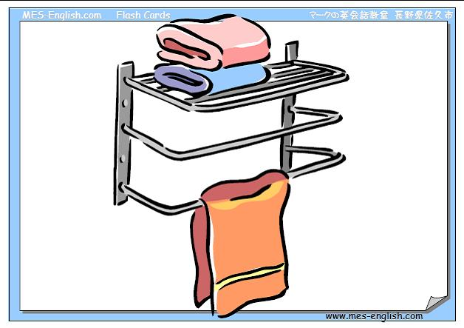
Towel rack

Slide 13
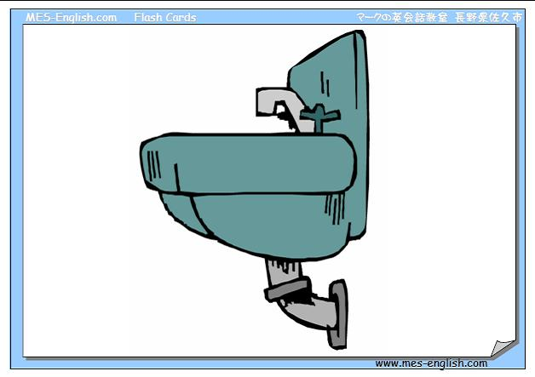
Sink

Slide 14
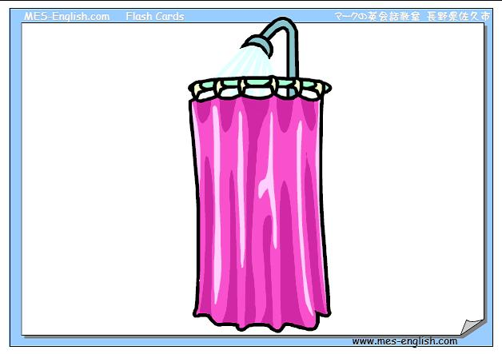
Shower

Slide 15
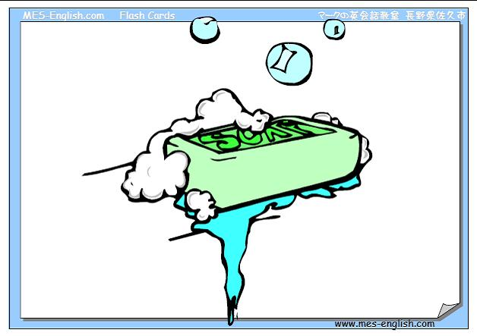
Soap

Slide 16
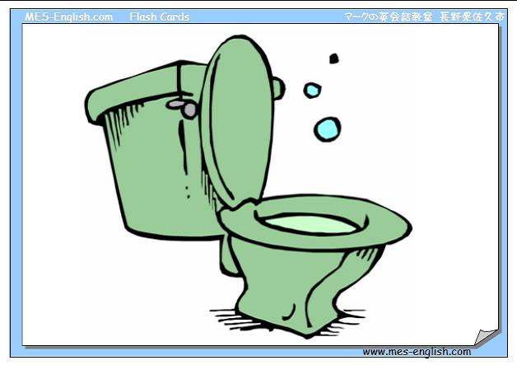
Toilet

Slide 17

Toilet paper

Slide 18
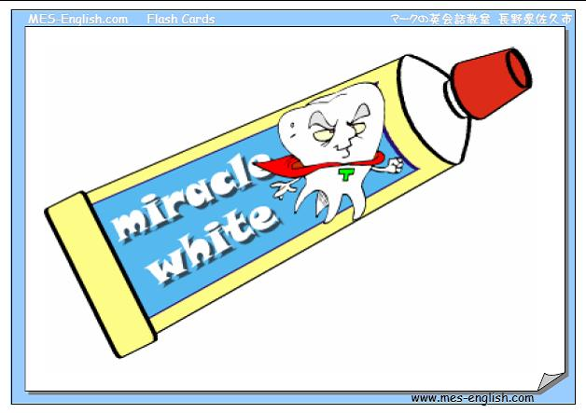
Toothpaste

Slide 19
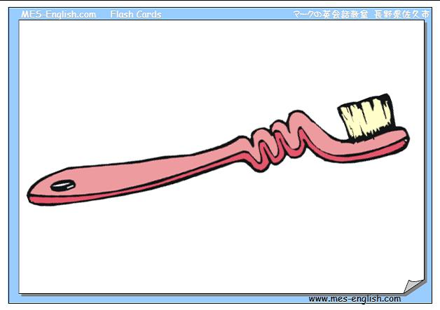
Toothbrush

Slide 20
After my bath
I try, try, try
to wipe myself
till I’m dry, dry, dry

Slide 21
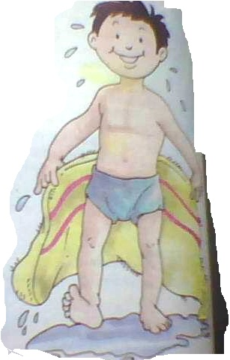
Hands to wipe
and fingers and toes
and two wet legs
and a shiny nose.

Slide 22

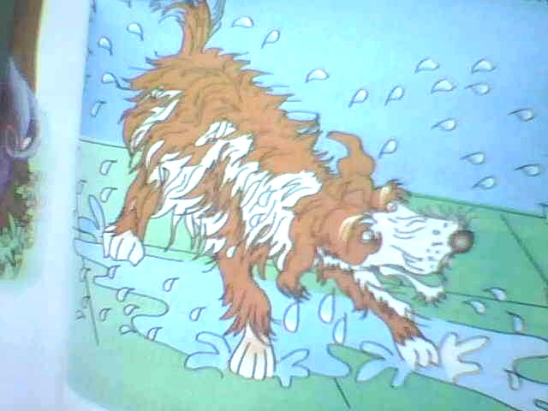
Just think how much
less time I’d take
if I were a dog

Slide 23
and could shake, shake, shake.

Slide 24


Slide 25


Slide 26
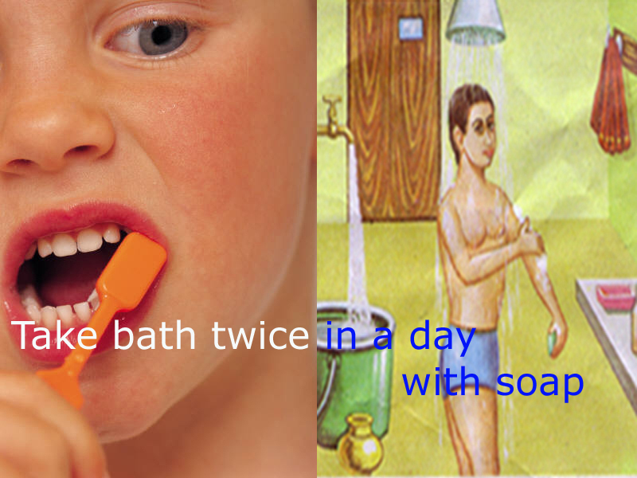

Slide 27


Slide 28
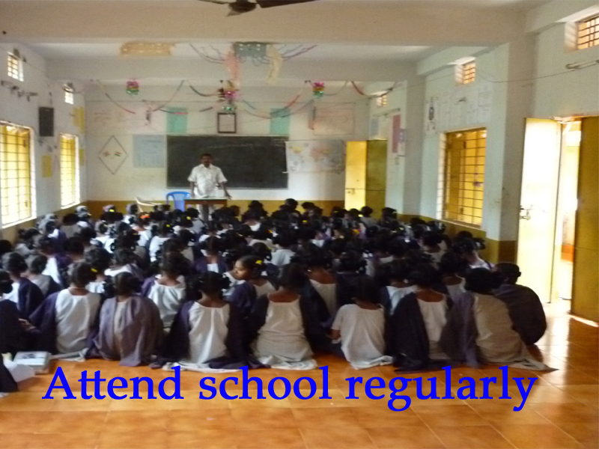

Slide 29


Slide 30

D. Srinivasa Rao PRT

Slide 31
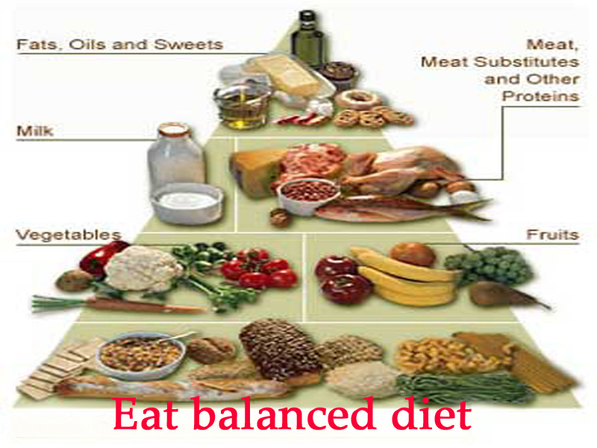
D. Srinivasa Rao PRT

