Slide 1
A smile

Slide 2
A smile is quite a funny thing

Slide 3
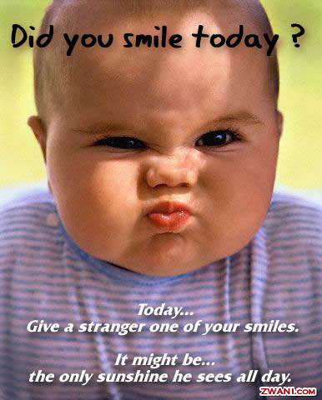
It wrinkles up your face

Slide 4
You ‘ii never find its secret hiding place

Slide 5
But far more wonderful it is to see what smiles can do

Slide 6
You smile at one, he smiles at you

Slide 7
So one smile makes two

Slide 8
Smiling face

Slide 9
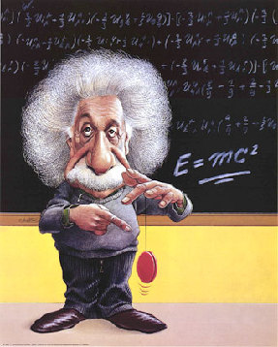
Wrinkled face

Slide 10
Angry face

Slide 11
Which is the longest word in the world

